Slide 1
Lecture 4: Perceptron and Back Propagation

Slide 2
Outline
Introduction to Neural Networks (very basic)
Introduction to Optimization
Gradient Descent
Stochastic Gradient Descent
Back Propagation
Single Neuron Network (‘Perceptron’)
Multi-Layer Perceptron

Slide 3
Motivation #1

Slide 4
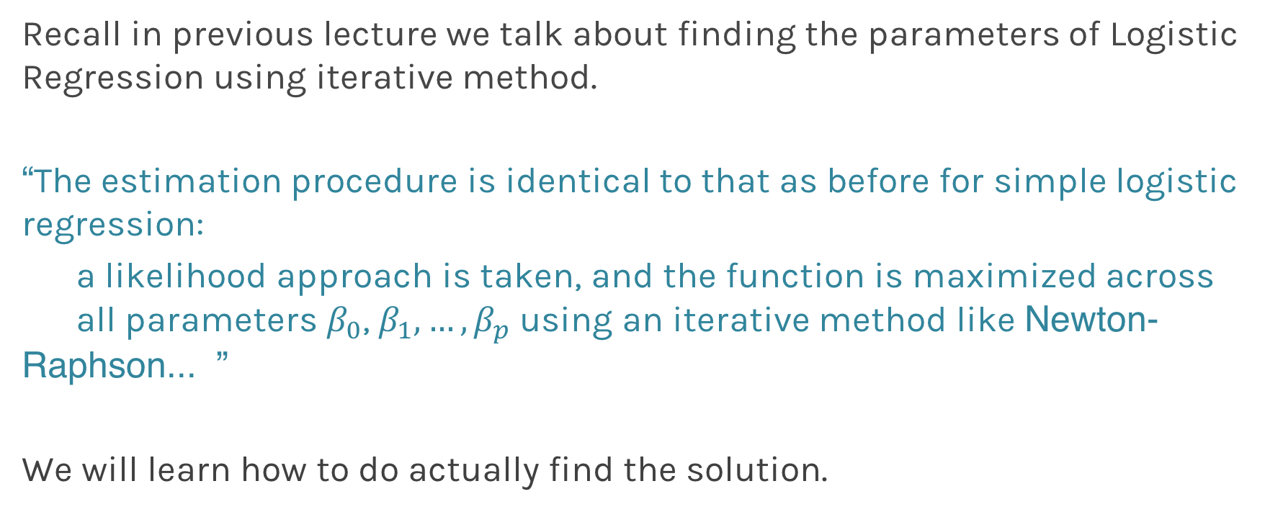
Finding parameters for Logistic Regression
Recall in previous lecture we talk about finding the parameters of Logistic Regression using iterative method.
“The estimation procedure is identical to that as before for simple logistic regression:
a likelihood approach is taken, and the function is maximized across all parameters $β_{0}$, $β_{1},…,β_{p}$ using an iterative method like Newton-Raphson... ”
We will learn how to do actually find the solution.

Slide 5
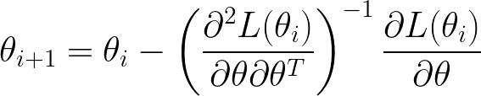
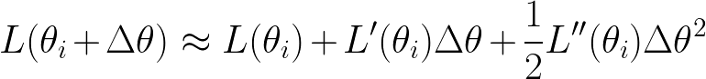
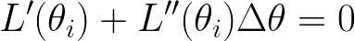
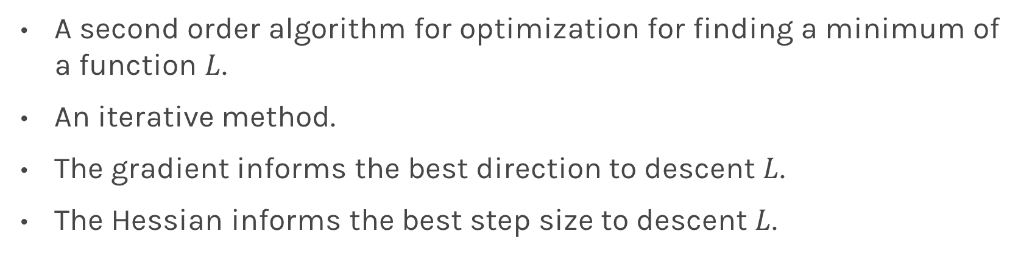
Newton’s Method
A second order algorithm for optimization for finding a minimum of a function $L$.
An iterative method.
The gradient informs the best direction to descent $L$.
The Hessian informs the best step size to descent $L$.

Slide 6
Motivation #2

Slide 7
Watch this!
http://video.arstechnica.com/watch/sunspring-sci-fi-short-film

Slide 8
Artificial Neural Networks

Slide 9

Today’s news

Slide 10

Today’s news

Slide 11
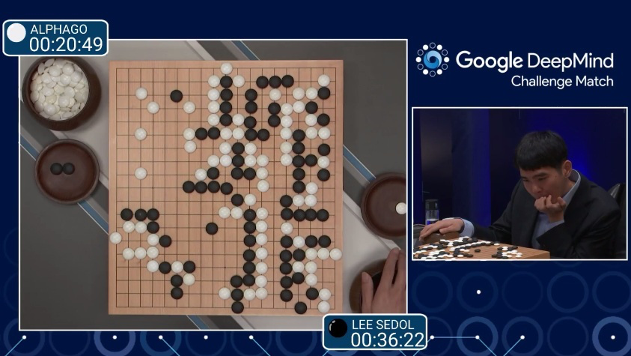
AlphaGo (2015)
First program to beat a professional Go player
Notes:
https://www.youtube.com/watch?v=PQCrX1sQSzY

Slide 12

AlphaZero (2017)

Slide 13

iOS Speech Synthesis (2016-)
Trained from 20 hours of high quality speech
machinelearning.apple.com
Notes:
https://machinelearning.apple.com/2017/08/06/siri-voices.html

Slide 14
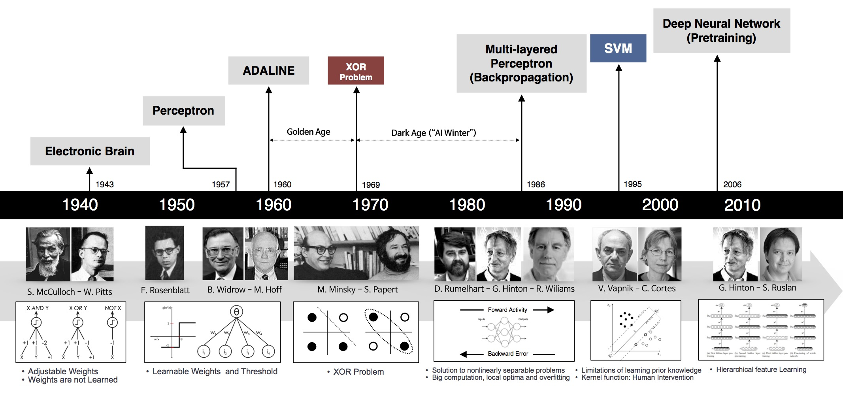
Historical Trends
beamandrew.github.io/

Slide 15
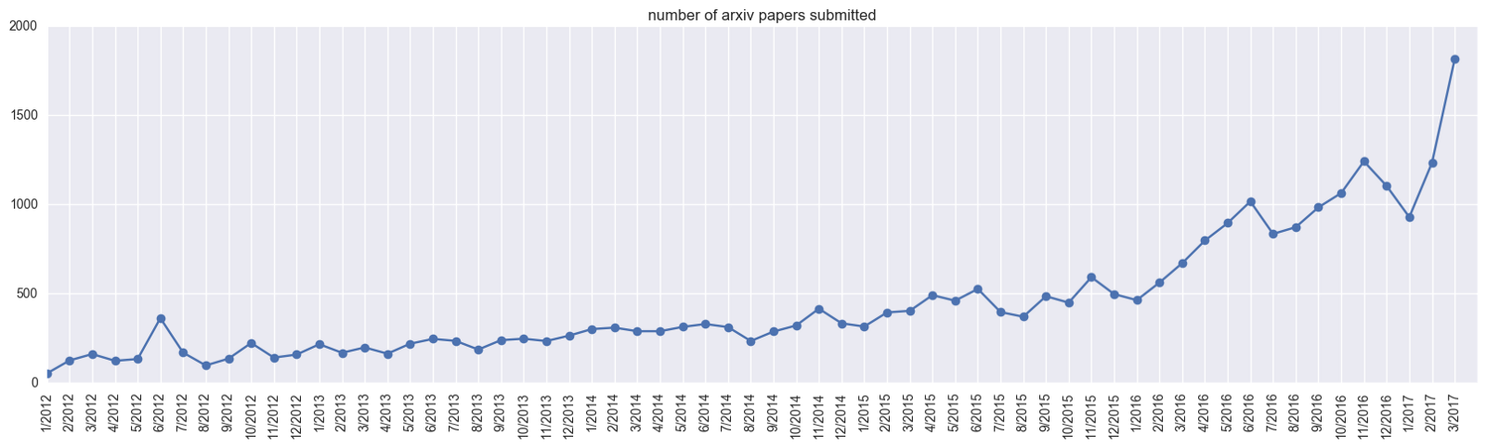
Historical Trends
ArXiv papers on deep learning: 2012-2017

Slide 16
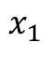
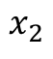
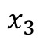
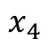
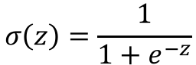
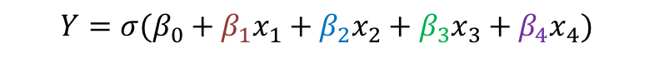
But what is the idea?
Start with Logistic Regression
$$σ\left(z\right)=\frac{1}{{1+e}^{−z}}$$
$$x_{1}$$
$$x_{2}$$
$$Y=σ(β_{0}+β_{1}x_{1}+β_{2}x_{2}+β_{3}x_{3}+β_{4}x_{4})$$
$$x_{3}$$
$$x_{4}$$
Intercept or Bias
Coefficients or Weights

Slide 17
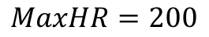
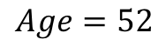
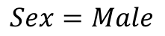
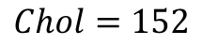
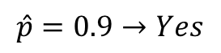
But what is the idea?
Start with all randomly selected weights. Most likely it will perform horribly.
For example, in our heart data, the model will be giving us the wrong answer.
$$MaxHR=200$$
$$Age=52$$
$$\hat{p}=0.9→Yes$$
y=No
$$Sex=Male$$
$$Chol=152$$
Bad Computer

Slide 18
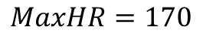
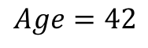
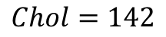
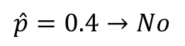
But what is the idea?
Start with all randomly selected weights. Most likely it will perform horribly.
For example, in our heart data, the model will be giving us the wrong answer.
$$MaxHR=170$$
$$Age=42$$
$$\hat{p}=0.4→No$$
y=Yes
$$Sex=Male$$
$$Chol=142$$
Bad Computer

Slide 19
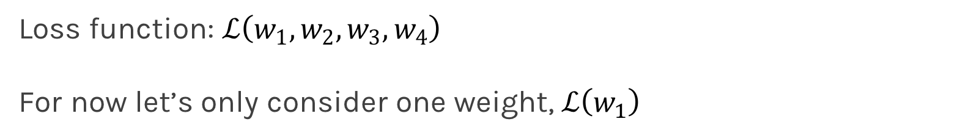
But what is the idea?
Loss Function: Takes all of these results and averages them and tells us how bad or good the computer or those weights are.
Telling the computer how bad or good is, does not help.
You want to tell it how to change those weights so it gets better.
Loss function: $ℒ\left(w_{1},w_{2},w_{3},w_{4}\right)$
For now let’s only consider one weight, $ℒ\left(w_{1}\right)$

Slide 20
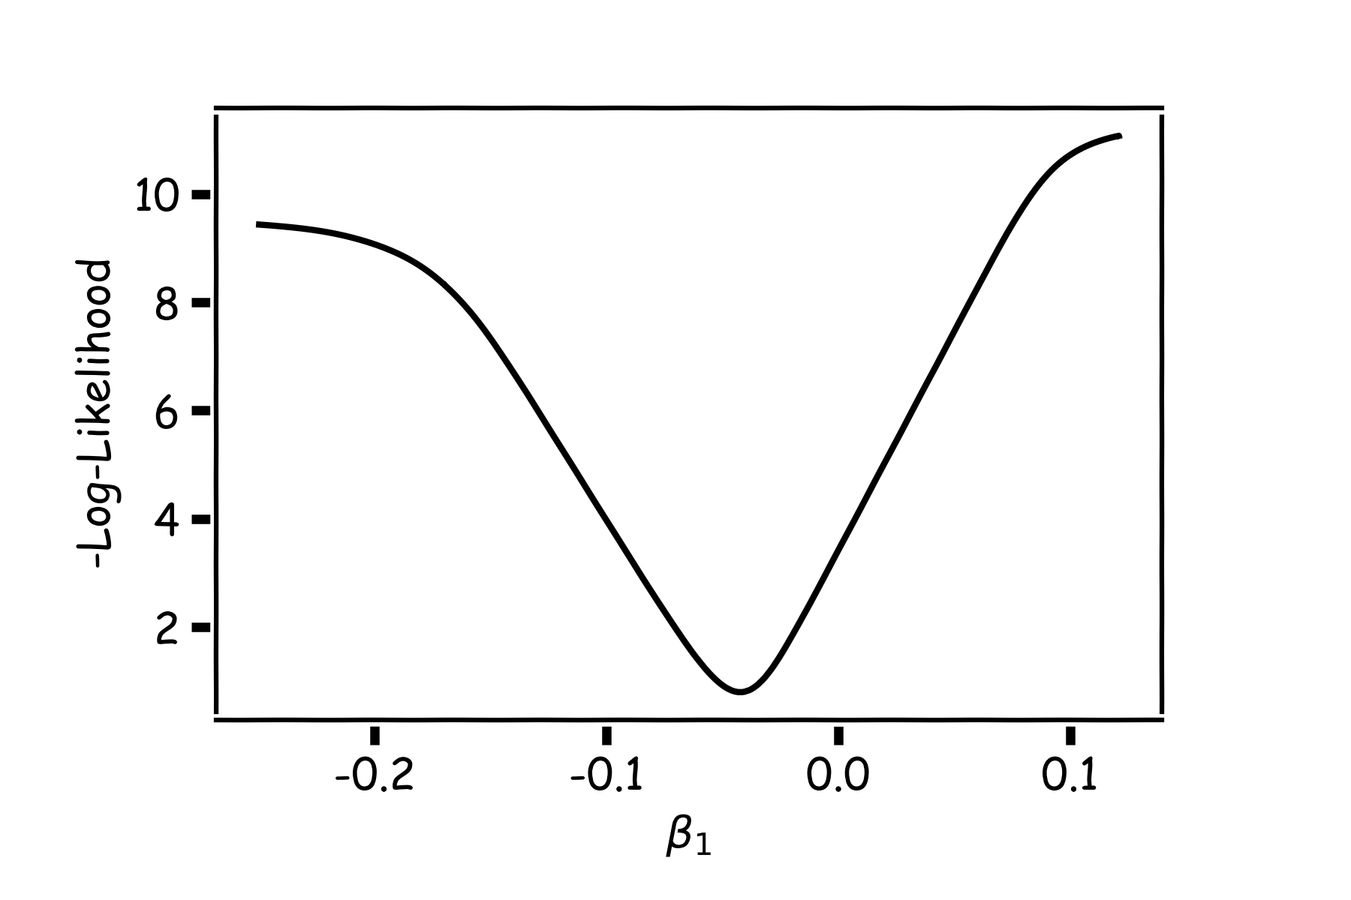
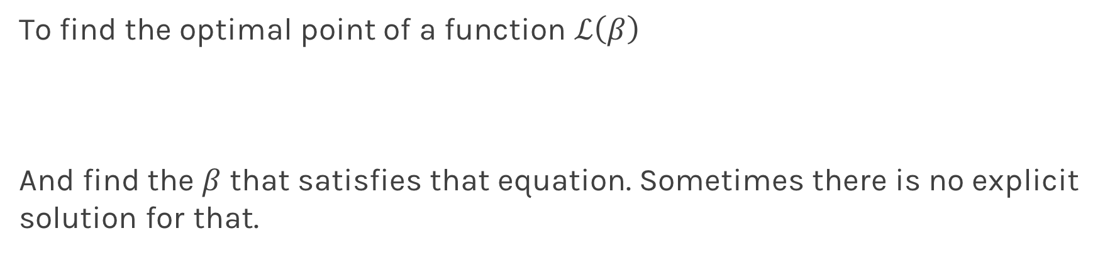
Minimizing the Loss function
To find the optimal point of a function $ℒ\left(β\right)$
And find the $β$ that satisfies that equation. Sometimes there is no explicit solution for that.

Slide 21
Minimizing the Loss function
A more flexible method is
Start from any point
Estimate which direction to go to reduce the loss (left or right)
Specifically if you can calculate the slope of the function at this point
Shift to the right if slope is negative or shift to the left if slope is positive

Slide 22
Minimization of the Loss Function
If the step is proportional to the slope then you avoid overshooting the minimum.
Question: What is the mathematical function that describes the slope?
Question: How do we generalize this to more than one predictor?
You want to tell it how to change those weights so it gets better.
Question: What do you think is a good approach for telling the model how to change to become better?

Slide 23
Minimization of the Loss Function
If the step is proportional to the slope then you avoid overshooting the minimum.
Question: What is the mathematical function that describes the slope? Derivative
Question: How do we generalize this to more than one predictor?
Take the derivative for each coefficient and solve a set of equations
You want to tell it how to change those weights so it gets better.
Question: What do you think is a good approach for telling the model how to change to become better?

Slide 24
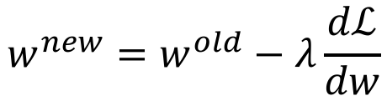
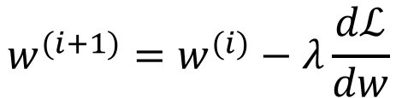
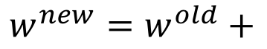
Let’s play the Pavlos game
We know that we want to go in the opposite direction of the derivative and we know we want to be making step proportionally to the derivative.
Making a step means:
$${w^{new}=w}^{old}+$$
Learning Rate
Inversely proportional to the derivative means:
$${w^{new}=w}^{old}−λ\frac{dℒ}{dw}$$
$${w^{(i+1)}=w}^{(i)}−λ\frac{dℒ}{dw}$$
Change to more conventional notation:

Slide 25
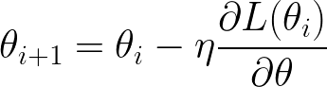
Gradient Descent
Algorithm for optimization of first order to finding a minimum of a function.
It is an iterative method
L is decreasing much faster in the direction of the negative derivative
The learning rate is controlled by the magnitude
L
-
+
𝛉

Slide 26
Considerations
We still need to calculate the derivatives.
We need to know what is the learning rates or how to set it.
Local vs global minima.
The full likelihood function includes summing up all individual ‘errors’. Unless you are Kevin or Mark, sometimes this includes hundreds of thousands of examples.

Slide 27
Derivatives: Memories from middle school

Slide 28
Linear Regression

Slide 29
Chain Rule
“Chain rule” for computing gradients:
For deeper networks

Slide 30
Logistic Regression
We want to minimize the negative log-likelihood:
In order to do that as we saw earlier we want to find the derivatives:

Slide 31
Learning Rate

Slide 32
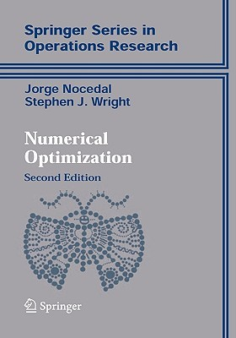
Learning Rate
Trial and Error
There are many alternative methods which address how to set or adjust the learning rate, using the derivative or second derivatives and or the momentum. To be discussed in the next ANN lecture.
J. Nocedal y S. Wright, “Numerical optimization”, Springer, 1999 🔗
TLDR: J. Bullinaria, “Learning with Momentum, Conjugate Gradient Learning”, 2015 🔗

Slide 33
Local and Global minima

Slide 34
Local vs Global Minima
L
𝛉

Slide 35
Local vs Global Minima
L
𝛉

Slide 36
Local vs Global Minima
No guarantee that we get the global minimum:
Question: What would be a good strategy?

Slide 37
Large data

Slide 38
Batch and Stochastic Gradient Descent
Instead of using all the examples for every step, use a subset of them (batch).
For each iteration k, use the following Loss function to derive the derivatives:
Which is an approximation to the full Loss function.

Slide 39
Batch and Stochastic Gradient Descent
Full Likelihood:
L
Batch Likelihood:
𝛉

Slide 40
Batch and Stochastic Gradient Descent
Full Likelihood:
L
Batch Likelihood:
𝛉

Slide 41
Batch and Stochastic Gradient Descent
Full Likelihood:
L
Batch Likelihood:
𝛉

Slide 42
Batch and Stochastic Gradient Descent
Full Likelihood:
L
Batch Likelihood:
𝛉

Slide 43
Batch and Stochastic Gradient Descent
Full Likelihood:
L
Batch Likelihood:
𝛉

Slide 44
Batch and Stochastic Gradient Descent
Full Likelihood:
L
Batch Likelihood:
𝛉

Slide 45
Batch and Stochastic Gradient Descent
Full Likelihood:
L
Batch Likelihood:
𝛉

Slide 46
Batch and Stochastic Gradient Descent
Full Likelihood:
L
Batch Likelihood:
𝛉

Slide 47
Batch and Stochastic Gradient Descent
Full Likelihood:
L
Batch Likelihood:
𝛉

Slide 48
Backpropagation

Slide 49
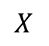
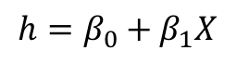
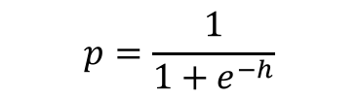
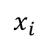
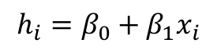
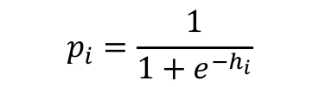
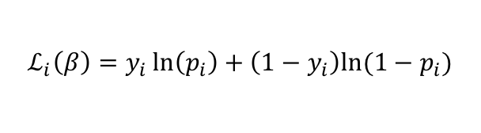
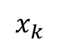
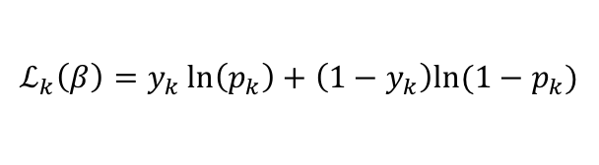
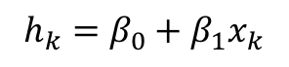
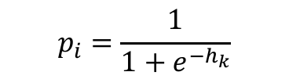

Backpropagation: Logistic Regression Revisited
Affine
Activation
Loss Fun
$$p_{i}=\frac{1}{1+e^{−h_{i}}}$$
$$x_{i}$$
$$h_{i}=β_{0}+β_{1}x_{i}$$
$$ℒ_{i}\left(β\right)=y_{i}\ln\left(p_{i}\right)+\left(1−y_{i}\right)ln⁡(1−p_{i})$$
Affine
Activation
Loss Fun
$$p_{i}=\frac{1}{1+e^{−h_{k}}}$$
$$x_{k}$$
$$h_{k}=β_{0}+β_{1}x_{k}$$
$$ℒ_{k}\left(β\right)=y_{k}\ln\left(p_{k}\right)+\left(1−y_{k}\right)ln⁡(1−p_{k})$$
…
Affine
Activation
Loss Fun
$$ℒ(β)=\sum_{i}^{n}{ℒ_{i}\left(β\right)}$$
$$p=\frac{1}{1+e^{−h}}$$
$$X$$
$$h=β_{0}+β_{1}X$$

Slide 50
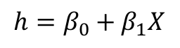
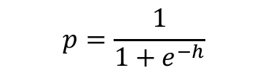
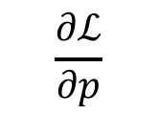
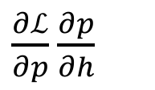
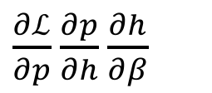

Backpropagation: Logistic Regression Revisited
Affine
Activation
Loss Fun
$$ℒ(β)=\sum_{i}^{n}{ℒ_{i}\left(β\right)}$$
$$p=\frac{1}{1+e^{−h}}$$
$$X$$
$$h=β_{0}+β_{1}X$$
$\frac{∂ℒ}{∂p}$ $\frac{∂p}{∂h}$ $\frac{∂h}{∂β}$
$\frac{∂ℒ}{∂p}$ $\frac{∂p}{∂h}$
$$\frac{∂ℒ}{∂p}$$

Slide 51
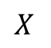
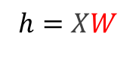
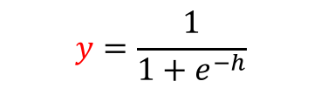





Build our first ANN
Affine
Activation
Loss Fun
$$ℒ(β)=\sum_{i}^{n}{ℒ_{i}\left(β\right)}$$
$$p=\frac{1}{1+e^{−h}}$$
$$X$$
$$h=β_{0}+β_{1}X$$
Affine
Activation
Loss Fun
$$ℒ(β)=\sum_{i}^{n}{ℒ_{i}\left(β\right)}$$
$$p=\frac{1}{1+e^{−h}}$$
$$X$$
$$h=Xβ$$
Affine
Activation
Loss Fun
$$ℒ(W)=\sum_{i}^{n}{ℒ_{i}\left(W\right)}$$
$$y=\frac{1}{1+e^{−h}}$$
$$X$$
$$h=XW$$

Slide 52





Build our first ANN
Affine
Activation
Loss Fun
$$ℒ(W)=\sum_{i}^{n}{ℒ_{i}\left(W\right)}$$
$$p=\frac{1}{1+e^{−h}}$$
$$X$$
$$h=XW$$
$$X$$
$$Y$$
Single Neuron Network
Very similar to Perceptron

Slide 53

Example Using Heart Data
Slightly modified data to illustrate concepts.

Slide 54



Example Using Heart Data
$$X$$
$$Y$$

Slide 55






Example
$$X$$
$$Y$$
$$X$$
$Y$’

Slide 56








Pavlos game #232
W₁
W₁
$$X$$
$$Y$$
$$h_{1}$$
$$h_{1}+h_{2}$$
$$X$$
W₂
W₂
$$h_{2}$$
$$X$$
$$Y′$$

Slide 57



Pavlos game #232
$$q= W_{31}h_{1}+{W_{32}h}_{2}+W_{30}$$
$$y=\frac{1}{1+e^{−q}}$$
W₁
W₁
$$X$$
$$Y$$
$$h_{1}$$
$$W_{3}$$
$$X$$
W₂
W₂
$$h_{2}$$
$$X$$
$$Y$$

Slide 58


Pavlos game #232
$$q= W_{31}h_{1}+{W_{32}h}_{2}+W_{\begin{aligned}30 \\ \end{aligned}}$$
$$p=\frac{1}{1+e^{−q}}$$
W₁
W₁
$$X$$
$$Y$$
$$h_{1}$$
$$W_{3}$$
$$X$$
W₂
W₂
$$h_{2}$$
$$X$$
$$Y$$
$$L=y ln\left(p\right)+\left(1−y\right)ln(1−p)$$

Slide 59



Example Code

Slide 60

Artificial Neural Networks
Machine Learning Algorithm
Very simplified parametric models of our brain
Networks of basic processing units: neurons
Neurons store information which has to be learned
Many types of architectures to solve different tasks
They can scale to massive data
They can train in parallel
...
...
...
...
...
99.9%
dog

